Slide 1
3rd session
10th March 2016
1

Slide 2
In the Long Run, the growth of money supply determines Inflation . Therefore, it makes sense to analyse the evolution of the foreign exchange rate based on the evolution of domestic money supplies.
The larger the money supply comparing with money demand, the lower must its value be.
If in the LR the inflation diferencials determine the exchange rate,
MONETARY THEORY
what determines inflation?
2

Slide 3
The Monetary Approach to the Determination of Foreign Exchange Rates
Money demand is a result of the need to trade. Therefore, it should be proportional to the volume of transactions (proportion k).
Quantity Theory of Money
M^{s}_{A}= k_{A}.P_{A}.Y_{A} and M^{s}_{B} = k_{B} .P_{B} .Y_{B}
M^{s}_{A}/ M^{s}_{B} = (k_{A}/k_{B}).(P_{A}/P_{B}).(Y_{A}/Y_{B})
(P_{A}/P_{B})= ( M^{s}_{A}/ M^{s}_{B}) / [(k_{A}/k_{B}).(Y_{A}/Y_{B})]
Combining the PPP (absolute) with the Quantitative Theory of Money, we have:
    S(b/a) = P_{A}/P_{B} = ( M^{s}_{A}/ M^{s}_{B}) / [(k_{A}/k_{B}).(Y_{A}/Y_{B})]
3

Slide 4
S(b/a) = P_{A}/P_{B} = ( M^{s}_{A}/ M^{s}_{B}) / [(k_{A}/k_{B}).(Y_{A}/Y_{B})]
Determinants of the appreciation of currency a in the LR (what is behind the lower increase in relative prices):
  Lower growth of the money stock.
  Larger growth of the real output.
  Increase in the ratio (k_{A}/k_{B}).
Some elasticities = 1.
  With everything else constant,
    1% increase in M^{s}_{A} → 1% depreciation of the domestic currency
    1% increase in M^{s}_{B} → 1% appreciation of the domestic currency
    1% increase in Y_{A} → 1% appreciation of the domestic currency
    1% increase in Y_{B} → 1% depreciation of the domestic currency
4

Slide 5
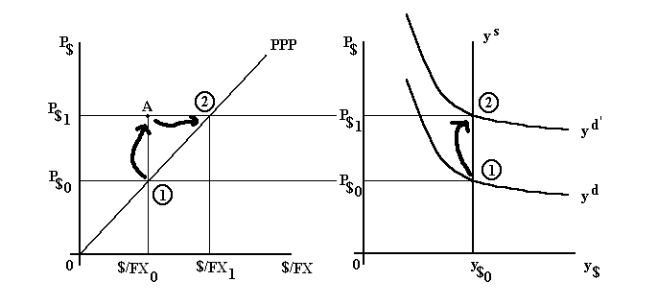
The Monetary Model with an increase in the money supply.
Source: Harvey, J. , 2007, Teaching Post Keynesian Exchange Rate Theory, Journal of Post -Keynesian Economics, 30, 2, 147-168
Note: Here, $/FX is the dollar price of the FCurrency, the opposite of our convention.
- Starting Point : PPP holds; In the LR the Y is the full employment.
Monetary Expansion: Increase in the demand from y_{d} to y_{d}’. Increase in P from P_{$0} to P_{$1}. Temporary unbalance (A) with a US déficit.
- Lower relative demand of $ in the foreign exchange market →depreciation of $.
5

Slide 6
  Typical Monetarist Conclusion:
  The variation of the Money Supply has an effect on the foreign exchange rate. In the Long Run, it has no real effect.
6

Slide 7
  EXERCISE 11 from Pugel, p.470
  In 1975, the price level for the US was 100, the price level for Pugelovia was also 100, and in the foreign exchange market one Pugelovian pnut was equal to $1. In 2008, the US price level had risen to 260, and the Pugelovian price level had risen to 390.
  According to PPP, what should the dollar-pnut exchange rate be in 2008?
  If the actual dollar-pnut exchange rate is $1/pnut in 2008, is the pnut overvalued or undervalued relative to PPP?

Slide 8
  EXERCISE 12 from Pugel, p.471
Here is further information on the US and Pugelovian economies.
  What is the value of k for the US in 1975? For Pugelovia?
  Show that the change in price level from 1975 to 2008 for each country is consistent with the quantity theory of money with a constant k.
 | 1975 |  |  | 2002
 | M^{S} | Y | P | M^{S} | Y | P
US | 20,000 | 800 | 100 | 65,000 | 1,000 | 260
Pugelovia | 10,000 | 200 | 100 | 58,500 | 300 | 390
8

Slide 9
  The SHORT TERM
Pugel, chap.18, 19
The Asset Market Approach to Foreign Exchange Rates
Most foreign exchange trades have a financial and not a comercial motive.
The asset market approach to foreign exchange rates emphasizes the role of the international investors. The price of a currency is the result of the combination of the demand and the offer of assets denominated in different currencies.
Capital Mobility
The interest rate parity indicates what to expect that happens to the foreign exchange rates in the short term.
The interest rate parity is a consequence of the interest rate arbitrage. Equilibrium condition of the financial markets.
9

Slide 10
Investment decision. In Lisbon, the interest rate is 6%. In NY, it is 8%. Where should one invest?
Foreign exchange risk.
If one wants to invest in a financial asset denominated in a foreign currency, one has to convert the initial value into the foreign currency, in order to buy the asset. The investment return will be denominated in the foreign currency needing conversion into the domestic currency, on a future moment.
What exchange rate is used to convert the foreign currency into the domestic currency, in the future?
If the forward foreign exchange rate is used, it is a covered international investment. If the future spot foreign exchange rate is used, it is an uncovered international investment
10

Slide 11
COVERED INTERNATIONAL INVESTMENT - Hedging
(The same type of analysis is used when someone borrows in the international market, instead of investing.)
Compare the alternative returns :
m.(1+i_{N}) and m.S(n/j).(1+i_{J}).F(j/n)
The covered interest differential = CD
(1+i_{J}).F(j/n)/S(j/n) – (1+i_{N})
IF CD>0, it is better to invest abroad (J).
IF CD<0, it is better to invest at home (N).
11

Slide 12
Define f (j/n) as [F(j/n) –S(j/n)] /S(j/n).
f is the premium. (Recall: IF f<0, j is at a discount and n is at a premium. IF f>0, j is at a premium and n at a discount.)
CD is approximately equal to f + (i_{J} –i_{N} ).
In order to be indifferent to invest in one country or in the other:
CD = 0 ⇔ F(j/n) /S(j/n) = (1+i_{N})/ (1+i_{J}) ⇔
F(j/n) /S(j/n) –1= (1+i_{N})/ (1+i_{J} ) –1 ⇔
f(j/n) = (1+i_{N})/ (1+i_{J} ) –1 ⇔
f(j/n) (1+i_{J} ) =i_{N} – i_{J}
12

Slide 13
Approximate COVERED INTEREST PARITY :
  f(j/n) =i_{N} – i_{J}
  CD>0 ⇔ f(j/n) > i_{N} – i_{J} ; CD<0 ⇔ f(j/n) < i_{N} – i_{J .}
The Covered Interest Arbitrage: Purchase a currency spot and sell it forward, profiting from the interest rate differential combined with the currency premium.
The Covered Interest Arbitrage leads to the Covered Interest Parity.
13

Slide 14
If interest parity does not exist, how is the equilibrium reestablished?
Suppose that (1+i_{J}).F(j/n)/S(j/n) – (1+i_{N}) > 0 and that it is best to borrow in N and invest in J.
  The demand for j and the supply of n, in the Spot foreign exchange market INCREASES
S(j/n) increases 
  The supply of j and the demand for n, in the Forward foreign exchange market INCREASES .
F(j/n) decreases 
In this analysis: interest rates as determinants of the foreign exchange rate in the Short Run.
14

Slide 15
There are no forward rates available for every currency, only for major international currencies. Additionally, an investor may wish to take the foreign exchange risk, either as a speculator or as a strategy of portfolio diversification.
UNCOVERED INTERNATIONAL INVESTMENT –
In this case, the future spot foreign exchange rate is used to convert the value of the international investment back into the original currency.
Similar to International Covered Investment, with S^{e}(j/n) instead of F(j/n).
15

Slide 16
The Expected Uncovered Differential = EUD :
(1+i_{J}). S^{e}(j/n) /S(j/n) – (1+i_{N}).
[S^{e}(j/n) –S(j/n)] /S(j/n) is not a premium but the expected appreciation rate of j.
UNCOVERED INTEREST PARITY:
  S^{e}(j/n)/S(j/n)= (1+i_{N})/ (1+i_{J}) .
  Equilibrium: Investment in the different currencies have the same expected rate of return.
In addition to the interest rates, also expectations are determinants of the foreign exchange rate in the Short Run.
16

Slide 17
The expectation of an appreciation of the currency of country J increases the attractiveness of current investments in that currency.
The relative demand for currency j in the FOREX increases. 
Currency j appreciates. 
In case of expectation of depreciation, the rationale is similar.
17

Slide 18
EXERCISE
If the 90 days interest rates i_{N} = 0,03 and i_{J} = 0,04, and the 90 days forward and the spot exchange rates are 2n per each j (f=0), how would arbitrage work?
18

Slide 19
  EXERCISE 8 from Pugel, p.440
  The following rates are available in the markets:
    Current spot exchange rate: $0.500/CHF
    Current 30-day forward exchange rate: $0.505/CHF
    Annualized interest rate on 30-day dollar-denominated bonds: 12% (1.0% for 30 days)
    Annualized interest rate on 30-day Swiss-franc-denominated bonds: 6% (0,5% for 30 days)
  Is the Swiss franc at a forward premium or discount?
  Should a US-based investor make a covered investment in Swiss franc-denominated bonds, rather than investing in 30-day dollar-denominated bonds? Explain.
  Because of covered interest arbitrage, what pressures are placed on the various rates? If the only rate that actually changes is the forward exchange rate, to what value will it be driven?
19

Slide 20
  EXERCISE 9 from Pugel, p.440
The following rates exist:
  Current spot exchange rate: $1.80/£
  Annualized interest rate on 90-day dollar-denominated bonds: 8% (2% for 90 days)
  Annualized interest rate on 90-day pound-denominated bonds: 12% (3% for 90 days)
  Financial investors expect the spot exchange rate to be $1.77/£ in 90 days.
  If he bases his decision solely on the difference in the expected rate of return, should a US based investor make na uncovered investment in pound-denominated bonds rather than investing in dollar-denominated bonds?
  If she bases her decision solely on the difference in the expected rate of return, should a UK based investor make na uncovered investment in dollar-denominated bonds rather than investing in pound-denominated bonds?
  If there is substantial uncovered investment seeking higher expected returns, what pressure is placed on the current spot exchange rate?
20

Slide 21
Empirical tests of the parity conditions
  Covered Interest Parity
    The premium must be approximately equal to the interest rate differential
    All variables are directly observable.
    Need to use compatible financial assets when comparing the interest rates (maturity and risk). For example, assets that are issued by the same institution but in different currencies so that the only risk is foreign exchange risk.
    Findings: without capital controls, parity tends to hold.
    Transactions cost, diﬀerential taxation across countries on the returns from investing in ﬁnancial markets, and political risk involved in investing in diﬀerent countries justify deviations from CIP. However, these deviations are small enough to assume that CIP holds true.

Slide 22
Transaction Costs
  Taking the case when it compensates to borrow in N to invest in J: (1+i_{J}).F(j/n)/S(j/n) – (1+i_{N}) > 0
  The arbitrageur borrows at i_{N}ª and invests at i_{J}^{b}
  Also, he purchases currency j spot at a foreign exchange rate S(j/n)ª, and sells it forward at F(j/n) ^{b}.
  This reduces profits.

Slide 23
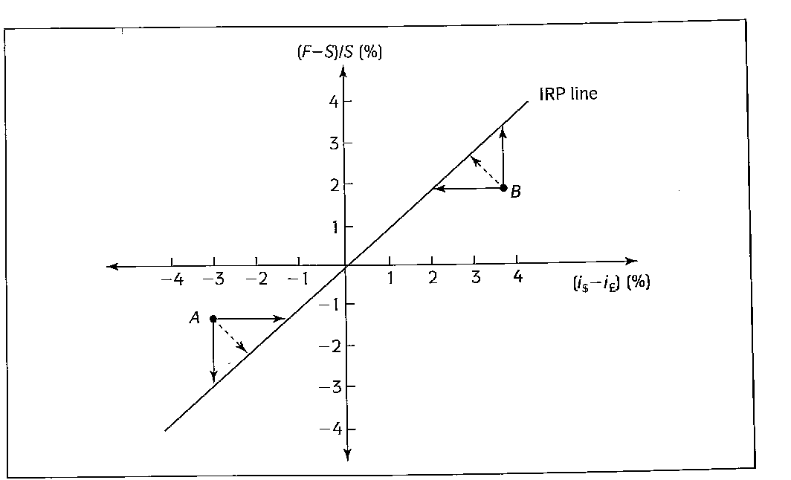

Slide 24
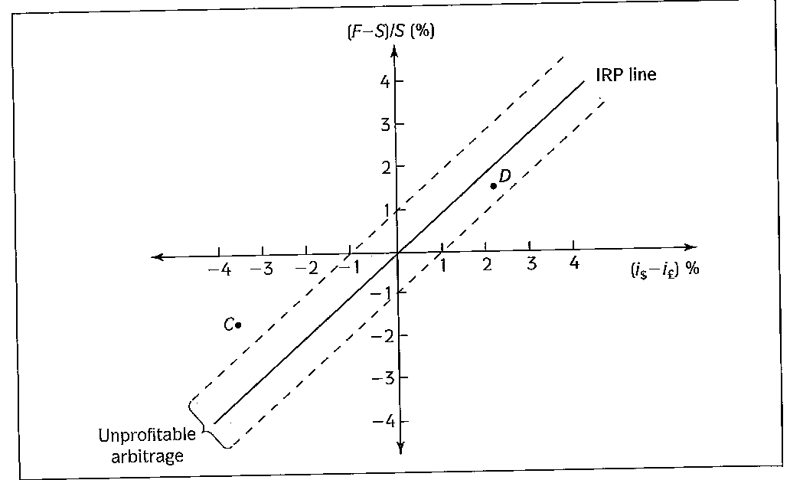


Slide 25
  Uncovered Interest Rate Parity
    The expected appreciation rate of the currency must be approximately equal to the interest rate differential.
    A higher interest rate in one country is compatible with an expected depreciation of that country’s currency.
    Not all the variables are directly observable: the expected foreign exchange rate.
    Solutions:
      Ask.
      Examine actual returns on uncovered international investments. If expected uncovered returns are usually (on average) at parity, over a large nr of investments the actual uncovered differentials should be approximately zero on average. Frequently, this is not found.

Slide 26
Studies - UIP does not hold in the data especially for the industrialized countries. Percentage change in expected future spot rate is not equal to interest diﬀerential.
  If the two parity conditions hold, then F_{t,t+h} = S^{e}_{t,t+h} .
  Explanations for deviations from UIP:
    Expectations Investors are systematically making mistakes in predicting the future value of spot exchange rate. Why especially over longer time periods do investors make big mistakes in a systematic fashion? Over time at least errors should shrink so that deviations from UIP became smaller.
    Risk aversion: there should be a premium to take a risk by not covering the investment. UIP takes into account only expected return.
      Uncovered Interest Differential = f(risk,riskaversion)

Slide 27
    Limited participation in the FX market: only a subset of potential investors is active in a given period.
      increase in the interest rate of a particular currency → increase in demand for that currency → appreciation of the currency.
      But when investors change infrequently their international portfolio positions, they will gradually buy the currency as time goes on, with a gradual appreciation. Meanwhile, deviations exist.
      Most of the international portfolios held over the medium run belong to institutions or individuals that are not active in the foreign exchange market.
    Problems in the statistical analysis of the data.
  Olmo e Pilbeam,UNCOVERED INTEREST PARITY AND THE EFFICIENCY OF THE FOREIGN EXCHANGE MARKET: A RE-EXAMINATION OF THE EVIDENCE Int. J. Fin. Econ. (2010)
      POSSIBLY, a COMBINATION of FACTORS.

